Slide 1







Stocktake of reporting progress and actions since last meeting
Energy Community Annual Meeting
Tallinn | 2 June 2026
© Wolf-Dietrich Hufenbach, Environment&Me 2025 / EEA

Slide 2
Session outline
Overview of the agenda of the event
Brief introduction of the EEA
Introducing the adapted Governance Regulation
Reporting progress
Actions since last year’s meeting
© Wolf-Dietrich Hufenbach, Environment&Me 2025 / EEA

Slide 3








Overview of the agenda
Day 1
Three examples of institutional capacity building.
Quality of reported data.
Presentation of the progress of assessment.
Stocktake of reporting progress and actions since last meeting.
Day 2
© Wolf-Dietrich Hufenbach, Environment&Me 2025 / EEA
What’s up ahead.
World cafe.
Notes:
I will present this slide, so no notes here.

Slide 4
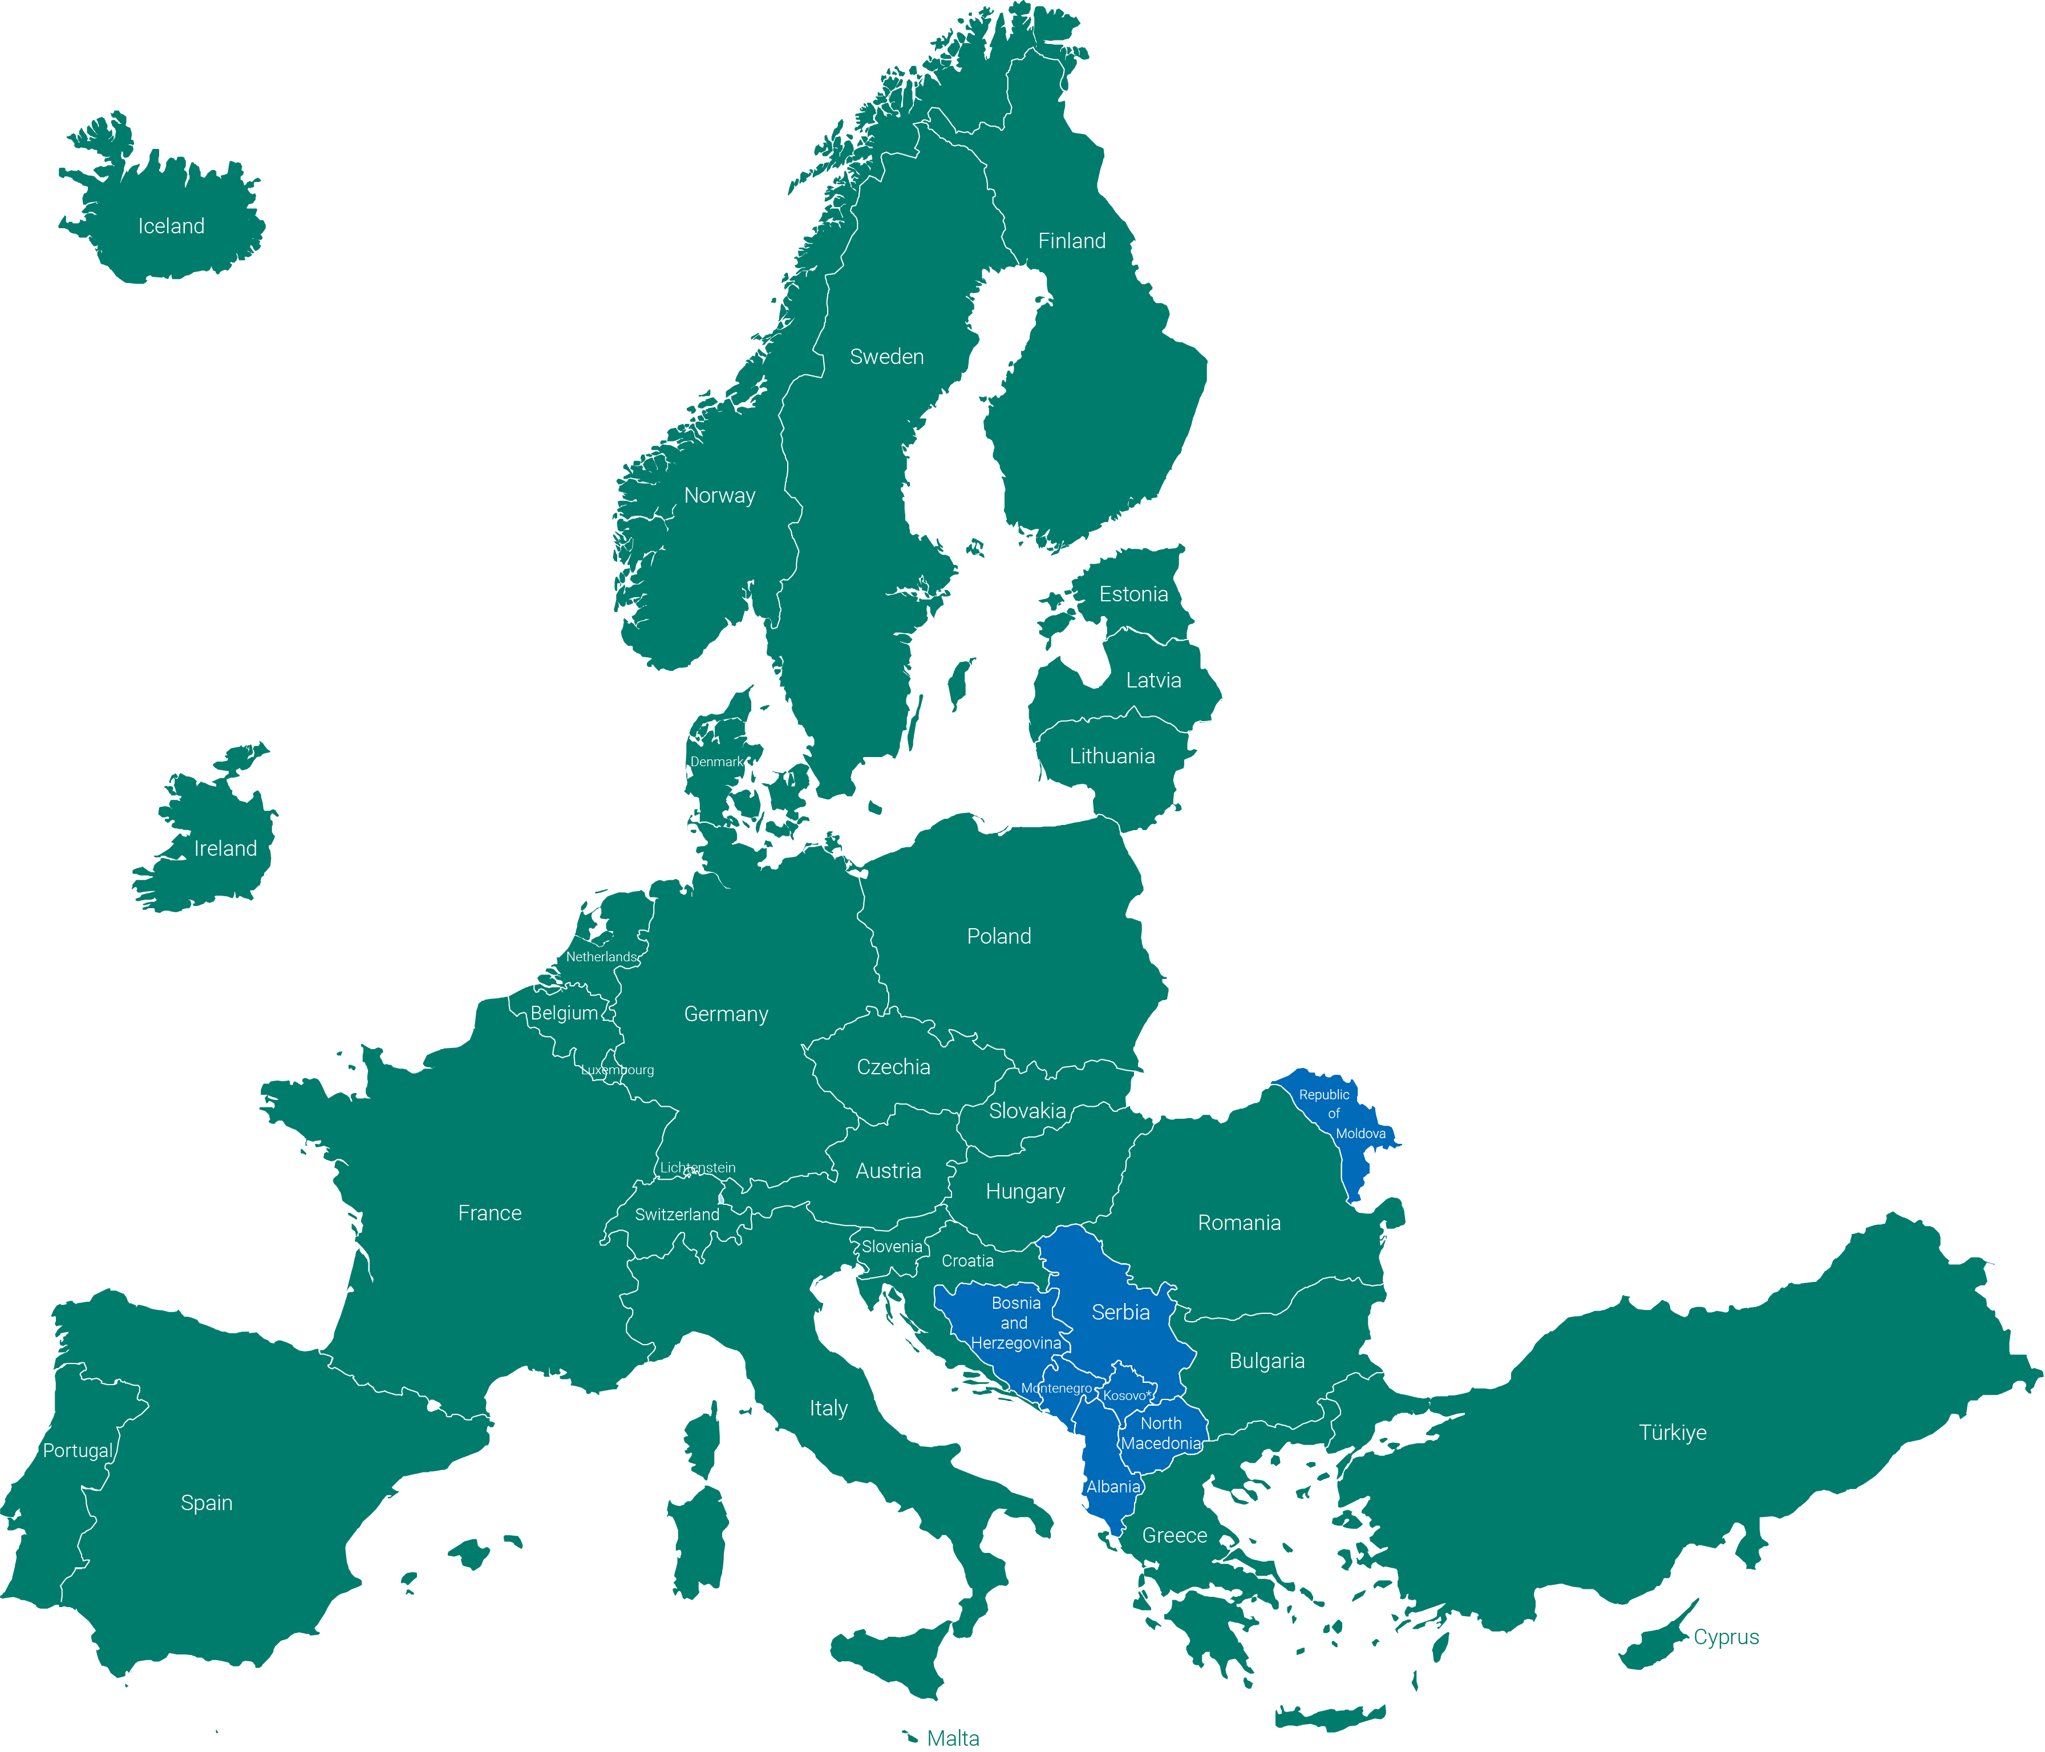
EEA-Eionet: a networking organisation
What we are and what we do
An independent EU agency
Data collection, analysis, assessment
39
countries
An interface between science and policy
A strong network organisation via Eionet
Member countries
Cooperating countries
What we don’t do
Propose or formulate legislation
Implementation of environmental measures
Providing funding to environmental measures
* This designation is without prejudice to positions on status and is in line with UNSCR 1244/99 and the ICJ Opinion on the Kosovo Declaration of Independence.

Slide 5










Collaboration: with a broad range of institutions
EU & pan-European
International
CLIMA, ENER, ENV, JRC, RTD, ESTAT, FISMA, SANTE, MARE, HERA, MOVE, ENEST, AGRI, DEFIS, ECHO
Among many others…

Slide 6
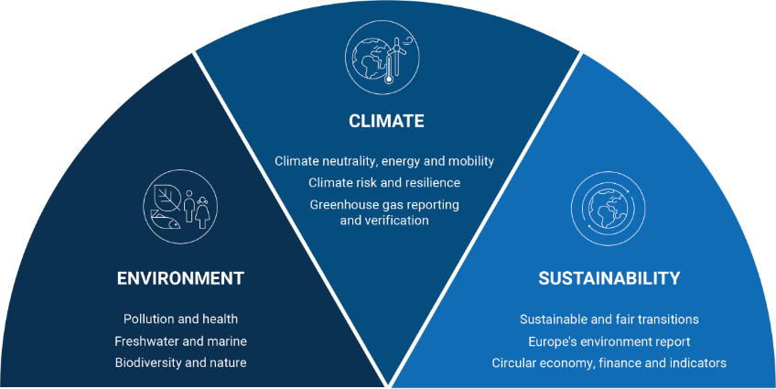
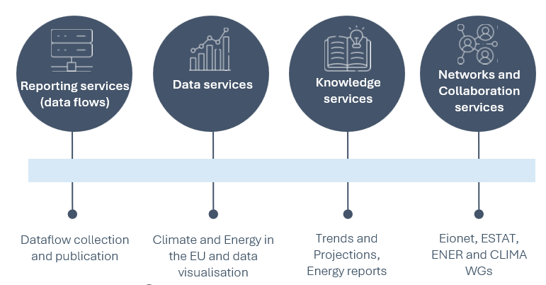
Areas of work
Notes:
EEA work across a wide spectrum of the ‘green’ topics. With the Governance Regulation and the data reported under this, this falls under the ‘Climate’ part. Environment
We support EU efforts to protect biodiversity and ecosystems through monitoring and analyses. We assess
environmental pollutants and climate impacts on health, focusing on exposure and vulnerability. Our work
advances the EU's zero-pollution goals and promotes a One Health approach linking human, animal, and
environmental well-being.
Climate
Europe faces rapid warming and rising climate risks. We aid climate mitigation by tracking emissions and
carbon removals. We help Europe adapt and become more resilient to unavoidable climate impacts. Our
assessments provide guidance in developing the EU's path to climate neutrality by 2050, and a resilient,
secure and competitive Europe, ensuring that progress benefits the economy and society without leaving
anyone behind.
Sustainability
Sustainability sits at the intersection of environment, society, and the economy. Our work focuses on key
levers of systemic change, including sustainable finance, innovation, and socio-economic trends and
enablers, as well as thematic areas such as foresight, systemic risk, and the circular economy.

Slide 7
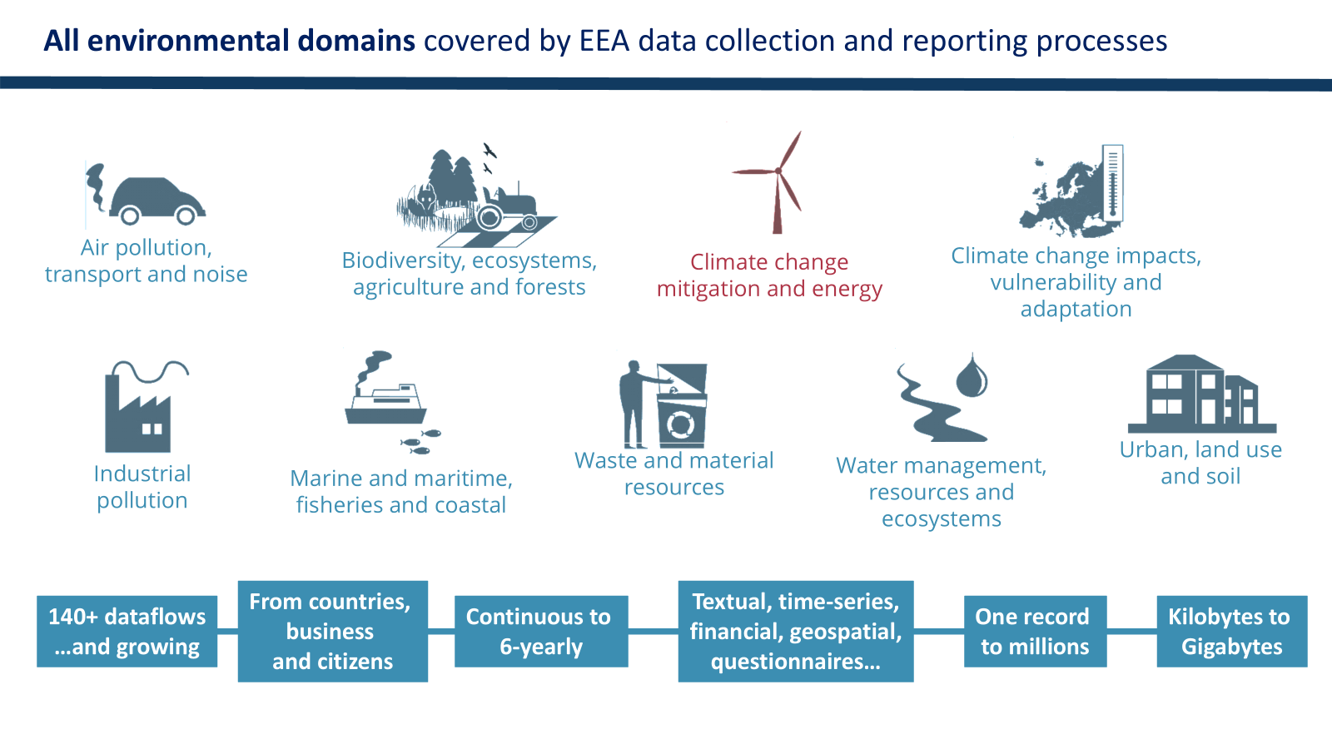

Slide 8
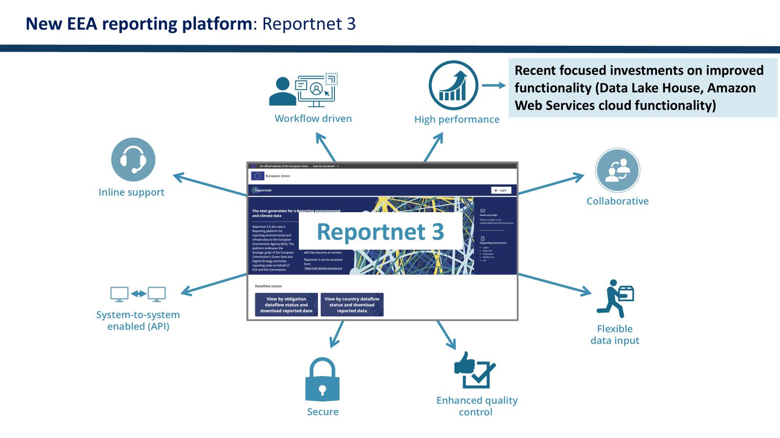

Slide 9
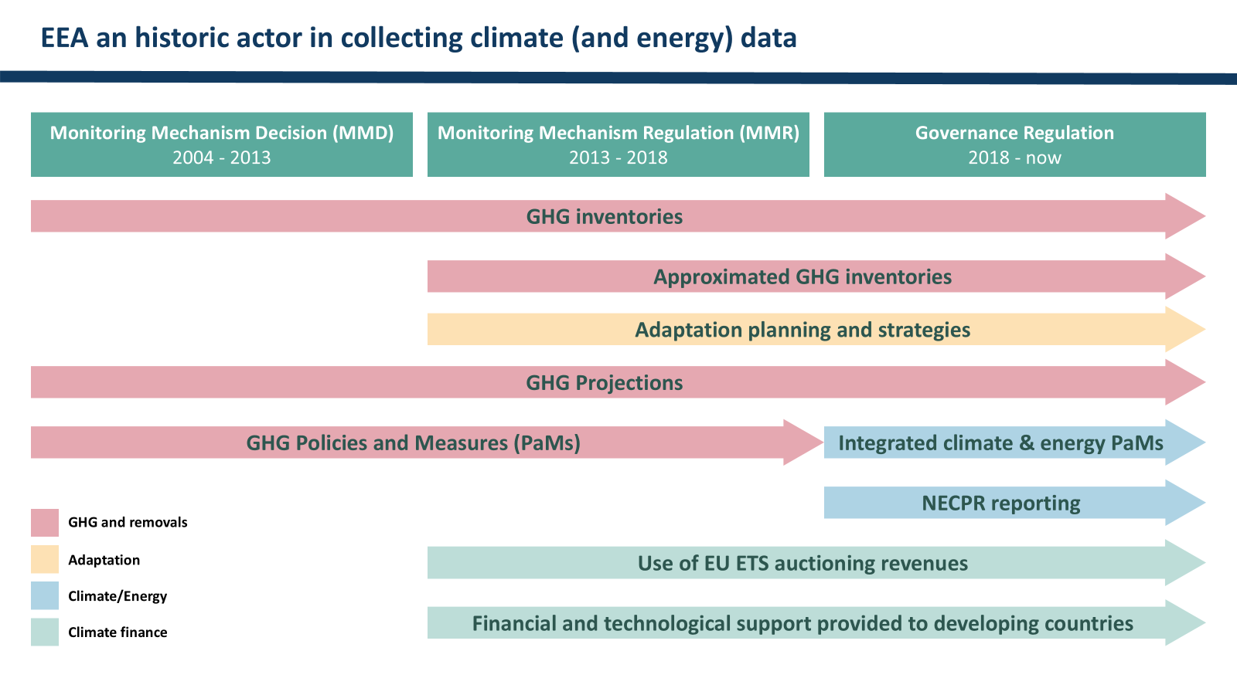

Slide 10
Governance Regulation: objectives
For EU to meet targets and objectives
Cooperation between Member States
High quality data for use in the international sphere (UNFCCC)
Increase regulatory and investor certainty
Governance Regulation 2018/1999: Article 1
Notes:
As mentioned, the EEA work with data across numerous topics, and one of these is the Governance Regulation, or GovReg. Before launching into the different data reporting obligations, it is good to take a few steps back. The Governance Regulation came into force in 2018, and it stands on three legs: Planning; Reporting; Assessment. More about these on the next slide, but for now the Governance Regulation introduced these legs with the purpose to create a governance framework for how Europe will meet the climate crisis challenge in a collaborative manner. As we know, achieving the decarbonisation we need to while increasing our resilience and preserving jobs and livelyhoods, and balancing security and geopolitical concerns is a delicate balancing act. The Governance Regulation builds on the foundation for how to handle this in the EU setting.
It does this through the three pillars: Member States have to plan what they will do, and publish this in their National Energy and Climate Plans (NECPs). In these, they set out targets for how their GHG emissions will develop, and targets for renewable energy generation and energy efficiency.
Then MS have to report on how they are progressing towards these targets. This is where the EEA mainly comes in – we gather the data from the MSs, quality check it, and compile it when necessary.
The European Commission then assesses how the MS are progressing. As we heard, we will hear more about this later today.

Slide 11
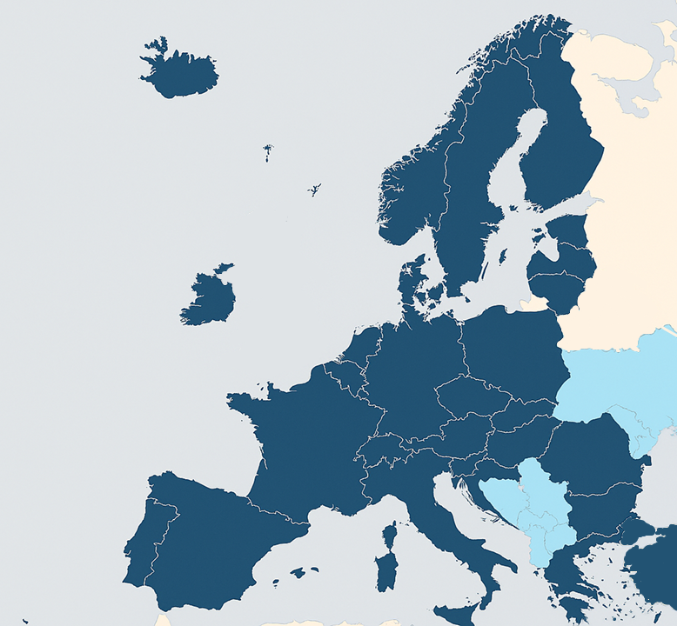
The adapted Governance Regulation
The Ministerial Council of the Energy Community on 30 November 2021 adapted and incorporated the Governance Regulation in the acquis Communautaire.
Gradual implementation, with the first reporting obligations entering in 2023. The draft Integrated NECPs were due on the 30 June 2023.
Contracting Parties have to prepare National Energy and Climate Plans (NECPs).
Based on the NECPRs, the Energy Community Secretariat assess progress towards the NECPs, and issues recommendations to the Contracting Parties.
Planning
Reporting
Assessing
Every two years, the Contracting parties submit progress reports towards their NECPs -- National Energy and Climate Progress Reports (NECPRs).
Notes:
How is this relevant for the Energy Community? Because an adapted version of the Governance Regulation is in force, including the Contracting Parties in the same cycle of planning, reporting, and assessing.
The Energy Community Treaty came into force in 2006 with the purpose to extend EUs energy market into the Western Balkans and the Black Sea region. As the climate and energy agendas have grown increasingly intertwined over the decades, topics such as decarbonization, energy efficiency, and renewable energy have become increasingly salient. With the Governance Regulation coming into force on the EU side in 2018, and reporting starting after this, this piece of regulation was also introduced in the Energy Community in 2021. Differences between the GovReg and adapted GovReg: They are more similar than they are different. With the adapted Governance Regulation, the Contracting Parties enter into the same planning –> reporting → assessment cycle as the EU Member State. So through the Governance Regulation, the Contracting Parties also developed and adopted NECPs with specific targets within greenhouse gas, renewable energy, and energy efficiency.
With reporting in particular, the CPs now report their climate and energy data according to the same formats and timelines as the EU Member States. This constitutes a significant acceleration of the reporting pace.
(If you want to highlight some differences, below are three points).
However, some differences exist as the Governance Regulation was adapted to the realities of the Contracting Parties.
- Important is that while the EUs emission are divided into what is covered by the EU ETS and the ESR (Effort sharing regulation), this distinction does not apply for the Contracting Parties. This required some adjustments of tables.
- The Governance Regulation and its timelines also exists to facilitate for the EU as a Party to the UNFCCC (Climate Convention) to submit its data on time to the UNFCCC. The EU as a Party to the Convention needs to submit a GHG Inventory on an annual basis which is a compilation of all of the EU MSs GHG Inventories. As the Energy Community is not a party to the UNFCCC, this same demand does not exist. This is, to some degree, reflected in the adapted version.
- In a few cases, the adapted version also requests less detailed data, for example when it comes to the LULUCF sector.
he Energy Community has nine Contracting Parties - Albania, Bosnia and Herzegovina, Kosovo*, North Macedonia, Georgia, Moldova, Montenegro, Serbia and Ukraine.
As of 2023 they started reporting on the GHG related elements of the adapted Governance Regulation.
As of 2025 they started reporting on the entire package of climate and energy requirements of the adapted Governance Regulation.
EEA mirrors its role for Member States with Contracting parties (i.e. setting up mirrored reporting tools, quality checking data, capacity building).

Slide 12
Reporting obligations
2026
2027
GHG Inventory 15 January: Draft GHG Inventory
15 March: Final GHG Inventory
31 July: Approximated Inventory
GHG Inventory 15 January: Draft GHG Inventory
15 March: Final GHG Inventory
31 July: Approximated Inventory
+ Comprehensive Review
Climate Finance
31 July: Use of any revenues generated from carbon price mechanisms
30 September: Support provided to developing countries
Mitigation
15 March: Integrated Policies and Measures (PaMs)
15 March: Greenhouse gas projections
15 March: NECPR reporting within GHG, RES, and EE
15 March: Additional reporting on RES and EE
Adaptation
15 March: National adaptation plans and strategies
15 March: NECPR reporting within adaptation
End of 2026:
UNFCCC BTR deadline
Climate Finance
31 July: Use of any revenues generated from carbon price mechanisms
30 September: Support provided to developing countries
Notes:
With the adapted Governance Regulation, a number of reporting obligations were introduced. As for the MS, reporting pendulums between high and low reporting years, with odd years being the high reporting years. This is because there are a number of reporting obligation that are only due on an biennial basis. A handful are due on an annual basis, first and foremost the GHG Inventory, these are all under 2026 on the slide.
For 2027, this is a high reporting year. You can see how the green and blue are repeated, but added the red and yellow boxes too. Within the red are the dataflows relating to mitigation, and within the yellow adaptation.
For the GHG Inventory, in 2027, the Comprehensive Review is also added. This is a more in-depth review of the submitted data, methodologies, assumptions and calculations compared to a normal year. It is mandated by the regulation, and Claire will describe it in more detail tomorrow, but it is important to have it on your horizon as it is a resource intensive period. However, very rewarding in terms of improvements to the GHG Inventory.

Slide 13
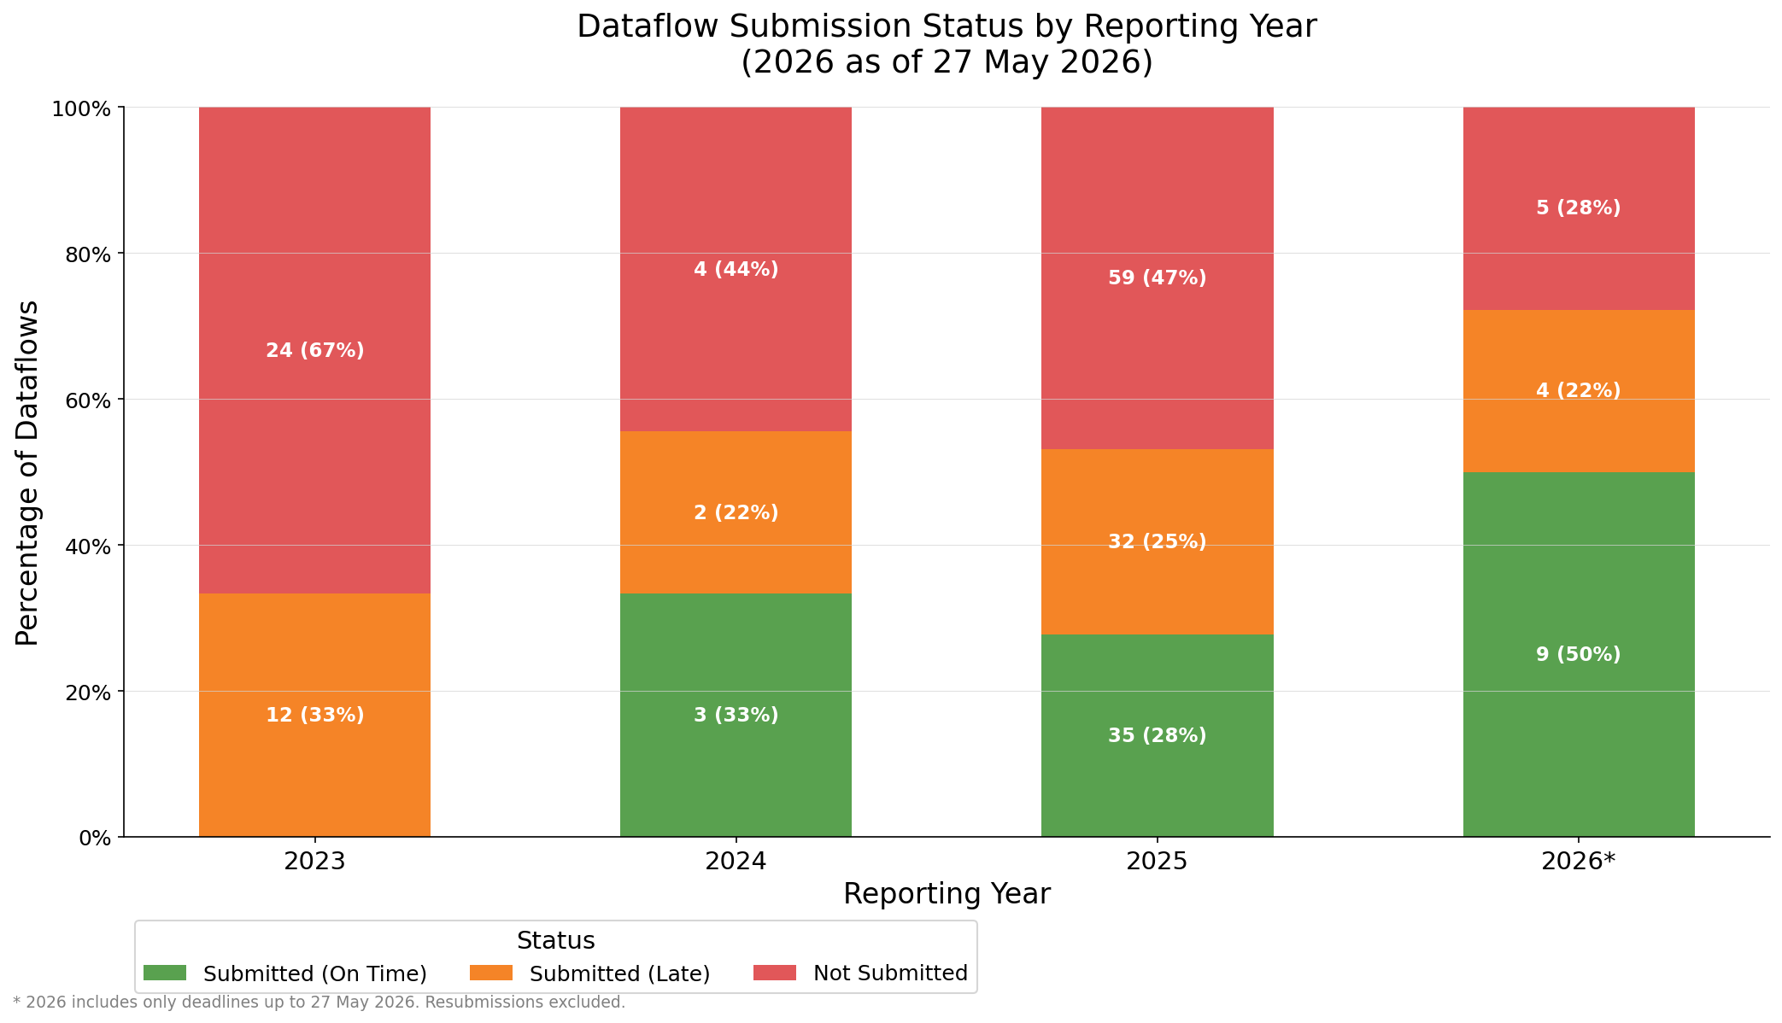
REPORTING SUBMISSION BREAKDOWN
Notes:
So since 2023, the CPs have had annual reporting obligations to the EEA under the adapted Governance Regulation. Let’s take stock on the progress.
The four bars are for each year – 2023, 2024, 2025, and up to this date, 2026. The numbers are the total number of reporting obligations due that year multiplied by the number of Contracting Parties. Basically, what we can see is an increasing trend of both timely (the green), and dataflow submitted but submitted late. This is an excellent trend that has continued for several years.

Slide 14
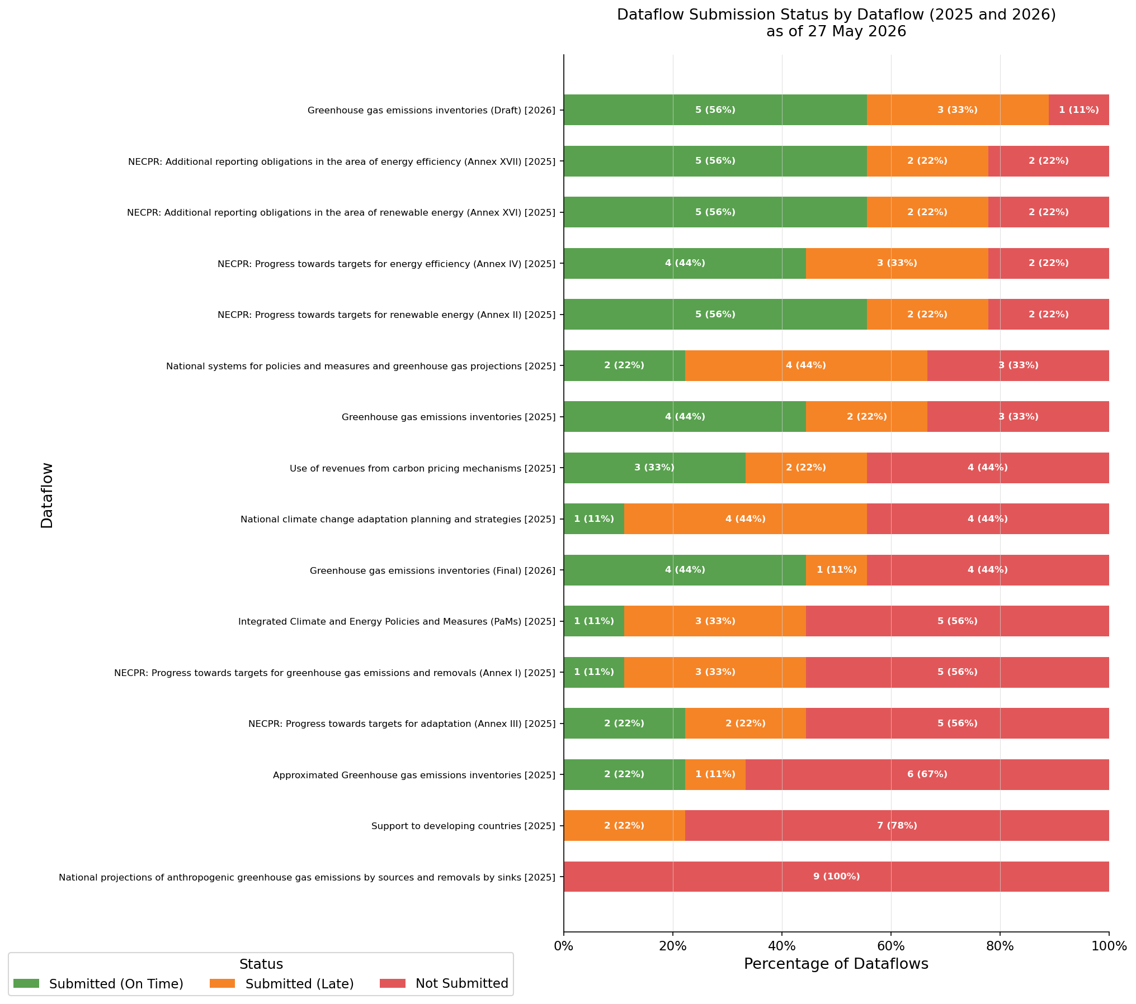
Draft GHG Inventories in 2026 – Most recent, and complex, highest degree of submission
Energy NECPR Dataflows in 2025 – high degree of reporting
Improvement since 2025
GHG NECPR dataflow – central dataflow, relatively low level of submissions.
GHG Projections – central dataflow, complex, no submissions yet.
Notes:
Overall: This shows the breakdown of submission per reporting obligation. Too much information on the slide to go through it all, but the main messages are:
Uneven distribution across the reporting obligations. This is to be expected as some dataflows are more complex to get the accurate data, and therefore therefore more complex to report on. Conversely, one of the most complex reporting obligation is the GHG Inventory, but here the level of reporting is the highest (click, it will be highlighted). This is no accident, as the GHG Inventory has been the backbone of climate reporting for decades, and where most resources have been invested to create the institutional capacity building. In essence, this high level of reporting is a testimony to that institutional capacity building works (together with a lot of hard work and will power).
You can also see the improvement since 2025 on this.
Similarly, the energy data which goes into the NECPR on renewable energy and energy efficiency also has a high level of completness. Energy data has also a long history behind it.
Here, the NECPR data on progress towards the target for GHG emission has a lower level of reporting – 1 timely submission, and 3 late, and 5 not reported at all. As this is a central dataflow on NECP progress, we need to see improvements here.
Lastly, a dataflow where we have seen no reporting to data is on GHG Projections. This is a complex dataflow, requiring access to much data and institutional coordination. From EEAs side, we are trying to support the best we can here.

Slide 15
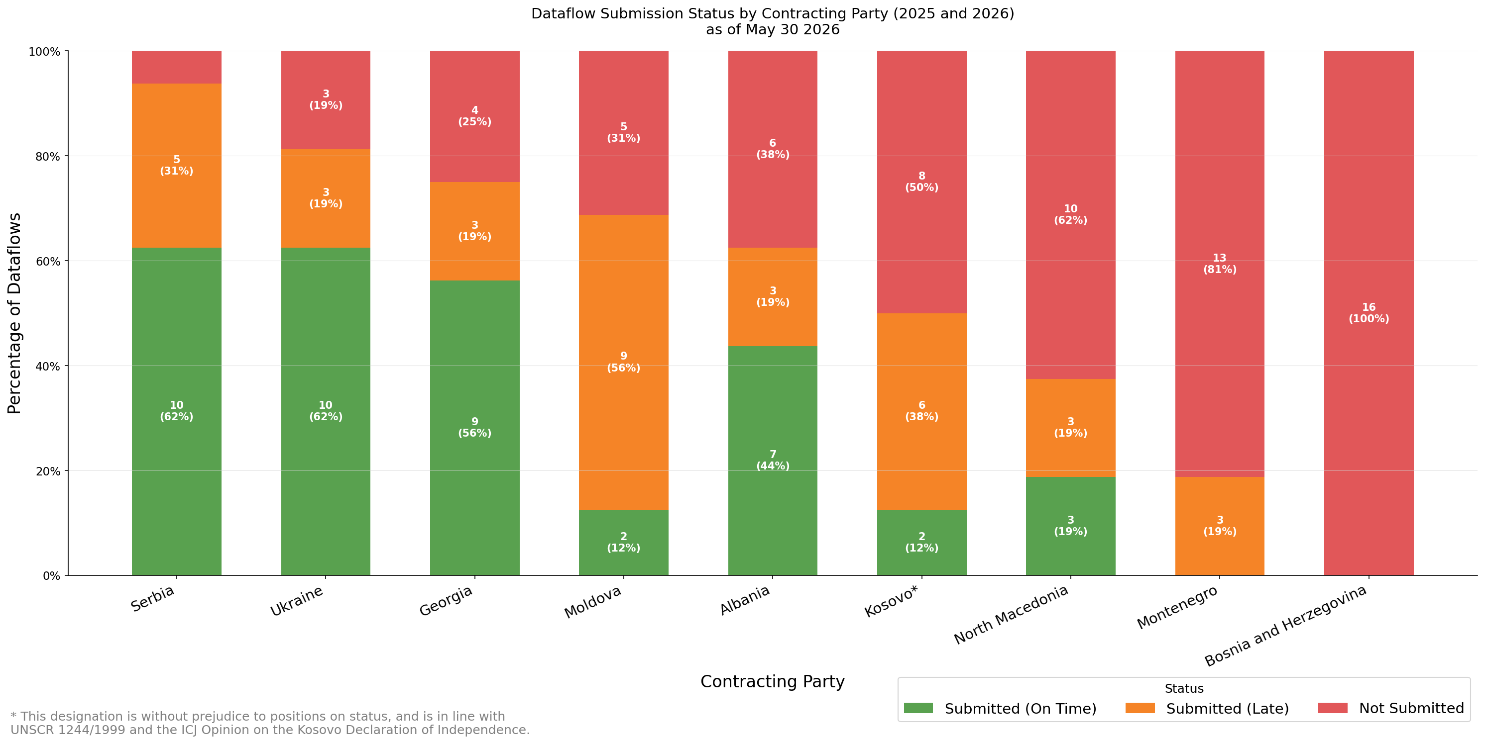
REPORTING SUBMISSION BREAKDOWN
Notes:
Here, we see it per Contracting Party instead.
Good performance of several CPs. However, no CP has managed to on all dataflows yet.
Over time, we have seen several CPs increasing the submission of reporting obligations (so increasing the orange). Montenegro should actually have 1 more submitted, and we know more are incoming. Often has happened in connection with trainings. While the training surely has helped, it also shows that the time after a training, the staff is more focused on this task, and manages to complete it.
Those who have submitted will be in a better position in 2027, as for many dataflows, then it is ”just” required to update the existing information.
For those CPs who are trailing in this chart, our encouragement and offer is that the EEA staff is avaiable to help through calls, virtual trainings, as well as national trainings.

Slide 16



Outcomes from last year's meeting
From last year’s meeting, the EEA and the Energy Community Secretariat shared a document summarizing the key outcomes, and actions we committed to. This was within the four areas of:
Institutional Reporting Coordination
Technical capacity building needs
Strategic and political relevance
IT systems
Notes:
Last year’s meeting we focused on accelerating reporting, and what support was needed to increase reporting levels, and to increase quality. After our discussions, we summarized this in a document (you have it available on the tables in printed form, and it was also shared after last years meeting, and prior to this meeting. Here, I want to highlight the outcomes we agreed, and show how we have integrated this into our work. The outcomes were divided in four areas – we will go through them one by one

Slide 17


Outcomes from last year's meeting
Institutional Reporting Coordination
Last year’s meeting noted:
Issues with weak inter-ministerial coordination, and unclear roles & mandates
Agreed Actions:
Beyond this:
EEA to share ToRs for reporters
EEA to share coordination practices through webinar and trainings
EEA has launched a study of CPs coordination practices to undestand the current status
Notes:
Insitutional Reporting Coordination. A clear discussion point was the challenge to created stronger inter-ministerial coordination, and unclear roles and mandates. In this we agreed to share the terms of reference for the reporters to clarify their roles, and the expectations on them. This we have done. In addition, we have also shared coordination practices through webinars and trainings, and will continue to do so.
Lastly on this point, we also saw the need to have better knowledge of the current status of the national systems in CPs. What legal framework exists, and what instutitional frameworks are in place. For this, we have commissioned a study that was launched last week that will describe the current status of national systems for policies and measures and projections.

Slide 18
Outcomes from last year's meeting
IT Systems
Last year’s meeting noted:
Misaligned internal reporting templates vs reporting requirements and templated in Reportnet
Agreed Actions:
Beyond this:
EEA has developed factsheets on the similarities and differences between the two reporting regimes
CPs are invited to share plans for national IT systems – offer still stands
EEA to continued to develop tools to facilitate transfer of data between UNFCCC and GovReg
Notes:
A second topic was regarding IT systems. Here, the agreement was that as Contracting Parties are developing their IT systems, the EEA could potentially advice on making them compatible with the reporting systems of the EEA. This offer still stands.
A second committment was that the EEA continues to develop tools to faciliate transfer of information between reporting systems, to reduce the reporting burden on the staff. Here, the EEA is continuing to develop these tools. While waiting for the tools to be ready, the EEA has developed fact sheets highlighting the similarities and differences, dataflow per dataflow. We have brought a few, and they are available here, and also of course digitally.

Slide 19
Outcomes from last year's meeting
Technical capacity building needs
Last year’s meeting noted:
Limited knowledge of reporting obligations and tools; strong demand for continued techical assistance, and increased peer learning
Agreed Actions:
Beyond this:
Webinars and in-person trainings have continued, with peer exchanged included
Strong forum for peer learning through ‘Working groups’
12 webinars
7 in-person trainings:
1 regional, 3 national,
3 technical exchanges
Notes:
A third topic was regarding technical capacity building needs, where there was a strong continued demand for this. The EEA have continued to provide this in various forms – through regional and national workshops, and also technical exchanges. These are still available upon request. The team will also present the workplan tomorrow where there are several plans, but please make a mental note if this could be useful in your specific case.
We are also working on establishing forums for peer learning. With so many CPs facing the similar challenges, the possibility to learn from each other is great. We have done this through webinars and trainings, but we are looking into ways of making it more systematic. But we need to take into account the small teams of many of the CPs to make it managable. If needed, the 7 in person trainings are: 1 regional (Vienna, Dec, -25) on Projections. 3 national trainings in Moldova (Sept, -25), Bosnia and Herzegovinga (Oct, -25), Kosovo (Nov, -25). 3 technical exchanges, Ukraine (Dec, -25), Moldova (Feb, -26), and Albania (April, -26).

Slide 20
Outcomes from last year's meeting
Strategic & Political Relevance
Last year’s meeting noted:
Strong strategic and political attention to reporting would benefit the process, securing more resources to build capacity and comply with deadlines.
Beyond this:
Agreed Actions:
Provide feedback through the QC processes
Integrated the reported data into the Energy Community Secretariat Assessment report
Publish and integrated the reported data into EEAs reports and indicators
Notes:
Lastly, we discussed how to increase the strategic and political relevance of reporting. We know that more resources are needed, but these need to be allocated, so how to ensure that they are allocated to this? We agreed that we would continue to provide feedback on the quality of the reported data, and in that way continue to show on the need for increased capacity building. Beyond this, the data has now been integrated into the Energy Community Secretariats assessment reports, as well as into EEA reports and indicators. In regards to publishing the data, this is an ongoing process where some of the reported data is already integrated into reports, visualisations, and available for download, while other is forthcoming shortly. But for example, the CPs data was integrated into the EEAs annual Trends and Projection report.

Slide 21
Key takeaways
Reporting progress:
We see an increasingly strong trend on timely submissions of reported data – this is great. Continue the good work, and if possible, dedicate more resources to it. The EEA remains available for technical support in many forms.
Reported data is integrated in EEAs and EUs data:
With the reported data, this is integrated into EEAs existing climate and energy data. This allows for a more complete European picture for analysis and assessment.
We listen to your input in these meetings:
Lastly, we show that we value your input in these meetings, and take action on the outcomes. Please engage actively in the remaining meeting.

